Slide 2
Types of Requirements
System Requirements
Business Rules (not a type of requirement but affects the requirements)
Non-Functional Requirements
Feature
Product vs Project Requirements

Slide 3
System Requirements
System requirements describe the requirements for a product that is composed of multiple components or subsystems.
A system can be all software or it can include both software and hardware subsystems. People and processes are part of a system, too, so certain system functions might be allocated to human beings.
The term “system requirements” is also used to mean the detailed requirements for a software system, but that’s not how we use the term in this course.

Slide 4
Example of System Requirements
A good example of a “system” is the cashier’s workstation in a supermarket.
There’s a bar code scanner integrated with a scale, as well as a hand-held bar code scanner. The cashier has a keyboard, a display, and a cash drawer. You’ll see a card reader and PIN pad for your loyalty card and credit or debit card, and perhaps a change dispenser. You might see up to three printers for your purchase.

Slide 5
Business Rules
Business rules include corporate policies, government regulations, industry standards, and computational algorithms.
Business rules are not themselves software requirements because they have an existence beyond the boundaries of any specific software application.
However, they often dictate that the system must contain functionality to comply with the rules.
We can trace the origin of certain functional requirements back to a particular business rule.

Slide 6
Examples of Business Rules
Credit Limit:
Customers with a credit limit above $1,000 can place orders without immediate payment, while others must pay upfront.
Refund Policy:
Refund requests can be made within 30 days of purchase, and refunds will be processed within 7 business days.
Pricing Calculation:
Calculate the total price of an order by summing up the prices of selected items and applying any applicable discounts or taxes.
Frequent Shopper Status:
After making 10 purchases within a year, customers are eligible for a 'Frequent Shopper' status, which grants them exclusive offers.

Slide 7
Non-functional Requirements
In addition to functional requirements, the SRS contains an assortment of non-functional requirements.
Non-functional (other-than functional) requirements might specify not what the system does, but rather how well it does those things.
Non-functional Requirements
Quality Attributes
Constraints
External Interfaces

Slide 8
Non-functional Requirements
Quality attributes are also known as quality factors, quality of service requirements, and the “–ilities.”
They describe the product’s characteristics in various dimensions that are important either to users or to developers and maintainers, such as performance, safety, availability, and portability.
External Interfaces include connections to other software systems, hardware components, and users, as well as communication interfaces.

Slide 9
Examples of External Interface Requirements
Single Sign-On (SSO):
The software may need to integrate with an SSO system, allowing users to use their existing credentials to access the software.
Notifications and Alerts:
The software might need to send notifications or alerts to users via email, SMS, or push notifications.
API Integration:
The software needs to integrate with third-party APIs to fetch data from external sources (e.g., weather data from a weather API).
The API endpoints, request formats, and response formats must be documented.
Hardware Compatibility:
The software must be compatible with specific hardware devices, such as printers, scanners, or sensors.
The software should handle device-specific protocols and configurations.
User Interfaces (UI) and User Experience (UX):
The software's UI should be consistent with the platform's design guidelines (e.g., Android Material Design or iOS Human Interface Guidelines).

Slide 10
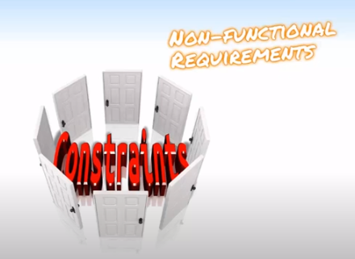
Constraints
A constraint is a restriction on the degree of freedom you have in providing a solution.
Constraints can be economic, political, technical, or environmental and pertain to your project resources, schedule, target environment, or to the system itself.
Design and implementation constraints impose restrictions on the options available to the developer during construction of the product.
Examples
The system will work on our existing technical infrastructure - no new technologies will be introduced.
The system will only use the data contained in the existing corporate database.
The system shall be available 99.99% of the time for any 24-hour period.
All master's degree programs must include the development of a thesis.

Slide 11
Constraints
Hardware Constraints:
The software must run on a specific operating system (e.g., Windows, Linux, macOS).
The software must be compatible with certain hardware configurations (e.g., minimum RAM, processor speed).
Performance Constraints:
The software must respond to user input within 2 seconds.
The application's memory usage should not exceed 100 MB.
Scalability Constraints:
The software should be able to handle a user base of at least 10,000 concurrent users.
The system must scale horizontally to accommodate increased demand.

Slide 12
Feature
A feature consists of one or more logically related system capabilities that provide value to a user and are described by a set of functional requirements.
A customer’s list of desired product features is not equivalent to a description of the user requirements.
A feature can encompass multiple user requirements, each of which implies that certain functional requirements must be implemented to allow the user to perform the task described by each user requirement.
Examples: Web browser bookmarks, spelling checkers, the ability to define a custom workout program for a piece of exercise equipment, and automatic virus signature updating in an anti-malware product are examples of features.
The following figure illustrates a feature tree, an analysis model that shows how a feature can be hierarchically decomposed into a set of smaller features, which relate to specific user requirements and lead to specifying sets of functional requirements (Beatty and Chen 2012).

Slide 13
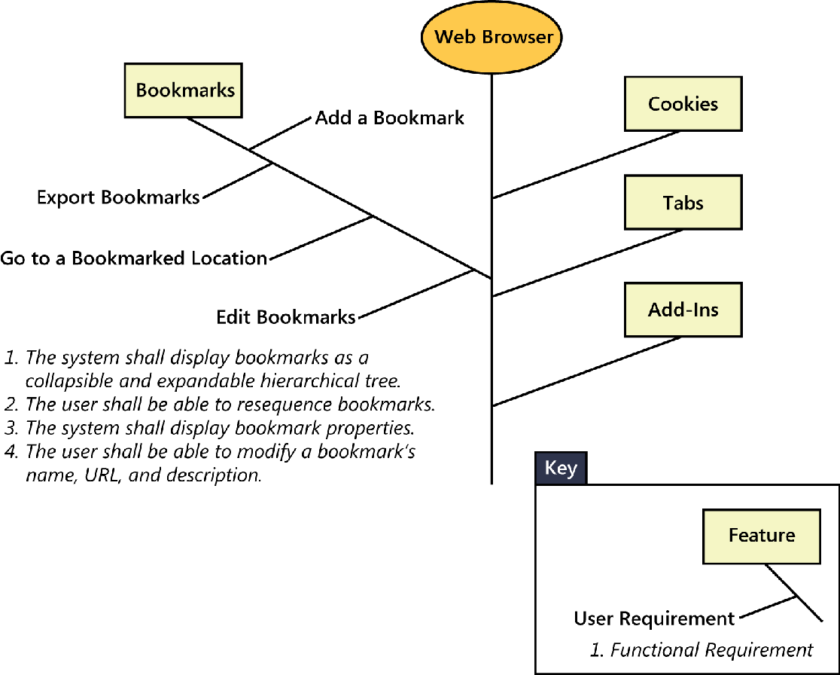
Feature Tree

Slide 14
Product vs Project Requirements
Product vs Project
A project has a defined beginning and end in time and is unique in that it is not a routine operation, but a specific set of operations designed to accomplish a singular goal.

Slide 15
Product vs Project Requirements
So far we have been discussing requirements that describe properties of a software system to be built. These are product requirements.
Projects certainly do have other expectations and deliverables that are not a part of the software the team implements, but that are necessary to the successful completion of the project as a whole. These are project requirements but not product

Slide 16
Examples of Project Requirements
Physical resources the development team needs, such as workstations, special hardware devices, testing labs, testing tools and equipment, team rooms, and videoconferencing equipment.
Staff training needs.
User documentation, including training materials, tutorials, reference manuals, and release notes.
Support documentation, such as help desk resources
Infrastructure changes needed in the operating environment.
Requirements and procedures for releasing the product, installing it in the operating environment, configuring it, and testing the installation.
Requirements and procedures for transitioning from an old system to a new one, such as data migration and conversion requirements, security setup, production cutover, and training to close skills gaps; these are sometimes called transition requirements.

Slide 17
Some more examples of Project Requirements
Product certification and compliance requirements.
Sourcing, acquisition, and licensing of third-party software and hardware components.
Beta testing, manufacturing, packaging, marketing, and distribution requirements.
Requirements for obtaining legal protection (patents, trademarks, or copyrights) for intellectual property related to the software.

Slide 18
4. Example to demonstrate different types of Requirements
Consider a project to develop the next version of a text editor program.
Increase non-US sales by 25 percent within 6 months
A multi-language spelling checker feature
Select language for spelling checker
Find spelling errors
Add a word to a dictionary
displaying suggested replacements, and globally replacing misspelled words with corrected words
Usability Requirement specifies how the software is to be localized for use with specific languages and character sets
Highlighting misspelled words
Autocorrect

Slide 19
Requirements Document
Requirements documents do not have to be traditional paper or electronic documents.
Think of them simply as containers in which to store requirements knowledge.

Slide 20
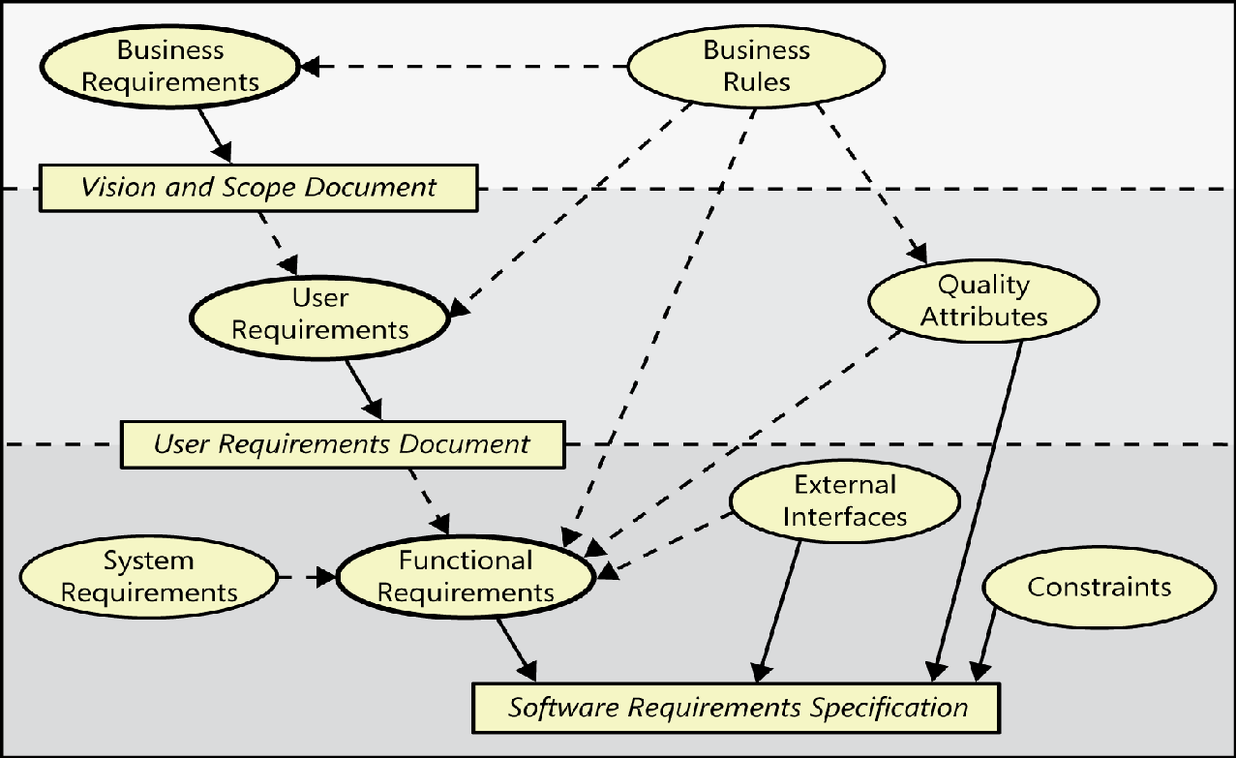
Relationships among several types of requirements information
The ovals represent
types of requirements information
The rectangles indicate documents
in which to store that information
The solid arrows indicate that a certain type of information typically is stored in
the indicated document.
The dotted arrows indicate that one type of
information is the origin of or influences
another type of requirement.

Slide 21
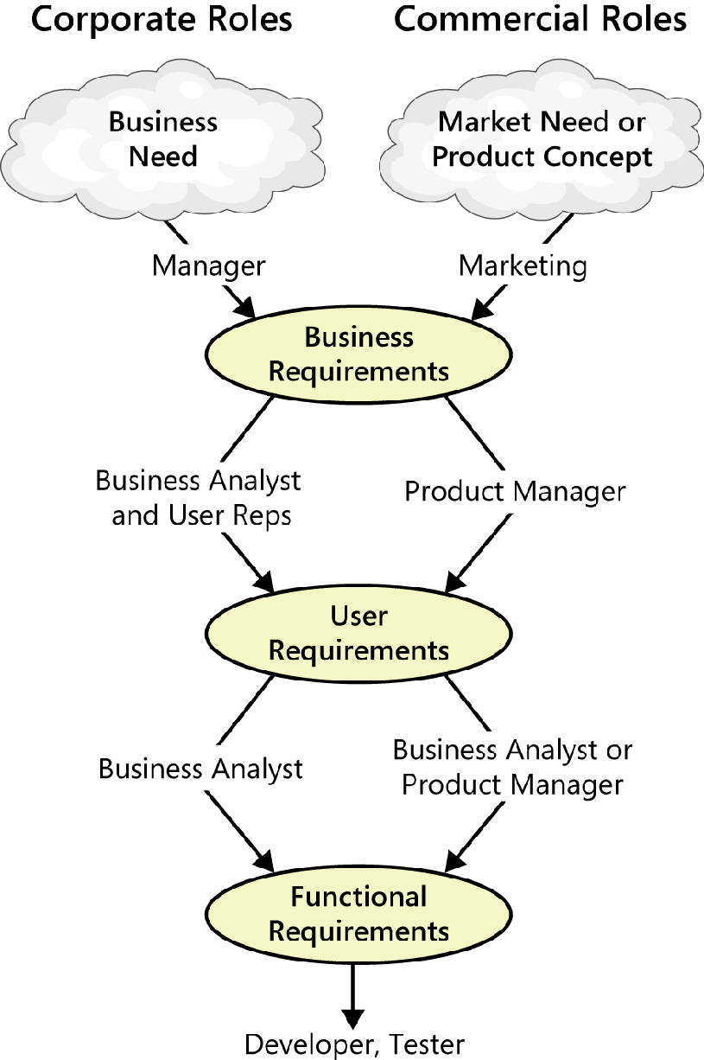
Different Roles in Requirements Engineering

Slide 22
Activities in Requirements Engineering Process
Requirements Elicitation
Requirements Analysis
Requirements Specification
Requirements Validation
Requirements Management

Slide 23
Requirements Elicitation
Elicit means “ to evoke or draw out (a reaction, answer, or fact) from someone”.
Elicitation Techniques
interviews,
workshops,
document analysis
prototyping, and others.
The key actions are:
Identifying the product’s expected user classes and other stakeholders.
Understanding user tasks and goals and the business objectives with which those tasks align.
Learning about the environment in which the new product will be used.
Working with individuals who represent each user class to understand their functionality needs and their quality expectations.

Slide 24
Requirements Analysis
Analysis is the process of breaking a complex topic or substance into smaller parts in order to gain a better understanding of it
Reaching a richer and more precise understanding of each requirement and representing sets of requirements in multiple ways.
Principal activities:
Analyzing the information received from users to distinguish their task goals from functional requirements, quality expectations, business rules, suggested solutions, and other information
Decomposing high-level requirements into an appropriate level of detail
Deriving functional requirements from other requirements information
Understanding the relative importance of quality attributes
Allocating requirements to software components defined in the system architecture
Negotiating implementation priorities
Identifying gaps in requirements or unnecessary requirements as they relate to the defined scope

Slide 25
Requirements Specification
Requirements specification involves representing and storing the collected requirements knowledge in a persistent and well-organized fashion.
The principal activity is:
Translating the collected user needs into written requirements and diagrams suitable for comprehension, review, and use by their intended audiences.

Slide 26
Requirements Validation
Requirements validation confirms that you have the correct set of requirements information that will enable developers to build a solution that satisfies the business objectives.
The central activities are:
Reviewing the documented requirements to correct any problems before the development group accepts them.
Developing acceptance tests and criteria to confirm that a product based on the requirements would meet customer needs and achieve the business objectives.

Slide 27
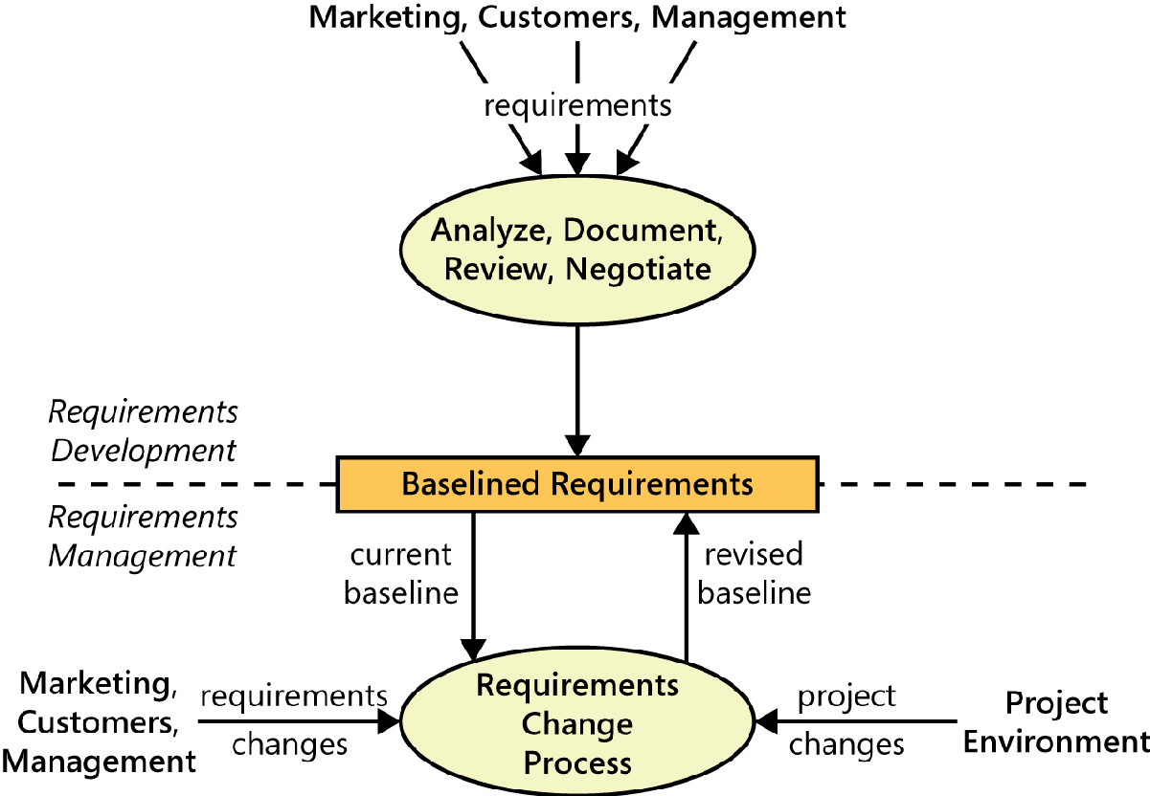
Requirements Management

Slide 28
Requirements Management
Requirements management activities include the following:
Defining the requirements baseline, a snapshot in time that represents an agreed-upon, reviewed, and approved set of functional and nonfunctional requirements, often for a specific product release or development iteration
Evaluating the impact of proposed requirements changes and incorporating approved changes into the project in a controlled way
Negotiating new commitments based on the estimated impact of requirements changes
Defining the relationships and dependencies that exist between requirements
Tracing individual requirements to their corresponding designs, source code, and tests
Tracking requirements status and change activity throughout the project

